Slide 1


Team Details
  Team name: HammerLimbo Tech
  Team leader name: Padmanabhan Rajendrakumar
  Problem Statement: Sustainability & Social Impact. Blind students cannot use the diagrams, graphs and maps in their textbooks; tactile versions are drawn by hand, one figure at a time, so most never reach them.

Slide 2
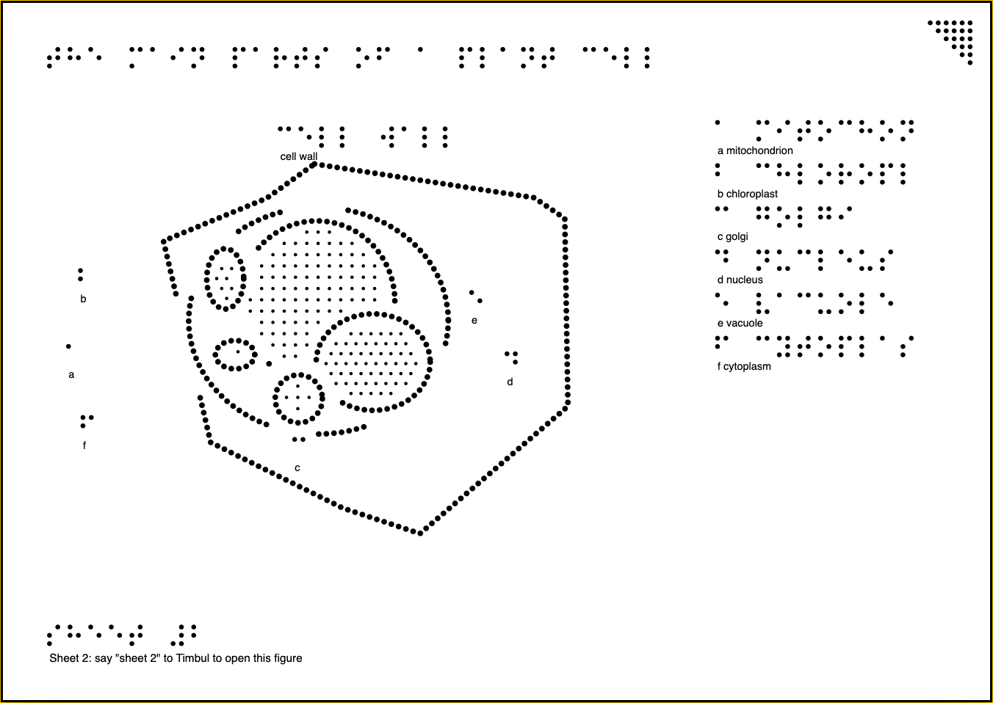
Brief about the idea
Timbul (Bahasa Indonesia: raised; to emerge)
Turns any textbook figure into a raised-dot sheet a blind student can feel, and a voice they can ask about it.
1
Teacher: Photographs one textbook page on a laptop or phone.
2
Gemini + Timbul: Gemini finds the figure, reads it, then checks its own drawing against the page and corrects it. Timbul's code draws it in raised dots with braille labels and checks tactile rules. The teacher approves, and prints an A4 sheet numbered in braille.
3
Student: Feels the printed sheet, says its number to open it in Timbul, and asks questions by voice, in English or Bahasa Indonesia.
A printed Timbul sheet: raised lines, braille labels and key, sheet number bottom left, orientation notch top right.

Slide 3
Opportunities
How is it different from existing ideas?
Image-description tools only say what a picture is, in words. Tactile drawings need a trained transcriber and hours per figure. Timbul does both halves together: an exact, rule-checked raised drawing and a voice that answers questions about that same figure.
43.3M
people are blind worldwide
The Lancet Global Health, 2021 (VLEG, GBD 2020)
How will it solve the problem?
One photo becomes a checked, print-ready tactile sheet in about a minute, against 1 to 5 hours by hand. The student explores it alone, by touch and by voice. Audio plus touch works: in one study blind students recalled 55% of a map's layout with an interactive audio model, against 29% with a raised-line map and braille legend (Giraud et al., Frontiers in Psychology, 2017).
12.0M
children and young people (0 to 19) in Southeast Asia live with vision loss
IAPB Vision Atlas, Southeast Asia (VLEG, GBD 2020)
USP
The model reads; our code draws. Gemini understands the figure, then Timbul's code places every dot and checks it, so what the student hears always matches what they feel. Built for Southeast Asia, in English and Bahasa Indonesia.
1 to 5 h
to draw one tactile figure by hand; a science textbook can hold 500 figures
Ladner et al., ASSETS 2005 (University of Washington)

Slide 4
List of features offered by the solution
1
2
3
4
Find, zoom, read
Gemini checks its work
Raised-dot drawing
Four rule checks
Gemini finds the figure on the page, Timbul crops to it, and Gemini reads the close-up: parts, positions, links.
Gemini lays its drawing over the page and corrects what is out of place. Tested: it caught a part we moved and put it back.
Every line as dots at true size, braille labels and key; many repeated items drawn as groups, not a tangle.
Lines 3 mm apart, braille clear of lines, at most 12 parts, every label in braille; crossings and near-misses fixed.
5
6
7
8
Teacher approves
Class library
Point and ask
Explore and ask
Nothing prints until a teacher compares it with the original. Print-ready A4 SVG, numbered in braille.
Approved sheets are numbered and shared by class code (Firestore). The student says “sheet two” to open one on any device.
The phone camera above the printed sheet: she touches a shape and asks “what is this?”; Gemini finds the fingertip and Timbul names the part.
An overview, part by part with keys, and any question by voice, in English or Bahasa Indonesia; answers spoken.

Slide 5
Process flow diagram or Use-case diagram
TEACHER
Photograph the page
Gemini finds and reads it
Gemini checks its drawing
Code draws, rules pass
Teacher approves, prints
the printed sheet goes to the student
STUDENT
Feels the sheet
Says the sheet number
Explores part by part
Points: “what is this?”
Asks; Gemini answers, spoken
Gemini does the understanding: finding and reading the figure, checking its own drawing against the page, hearing the question. Timbul's own code does the drawing, the braille and the rule checks, so the voice and the paper never disagree.

Slide 6
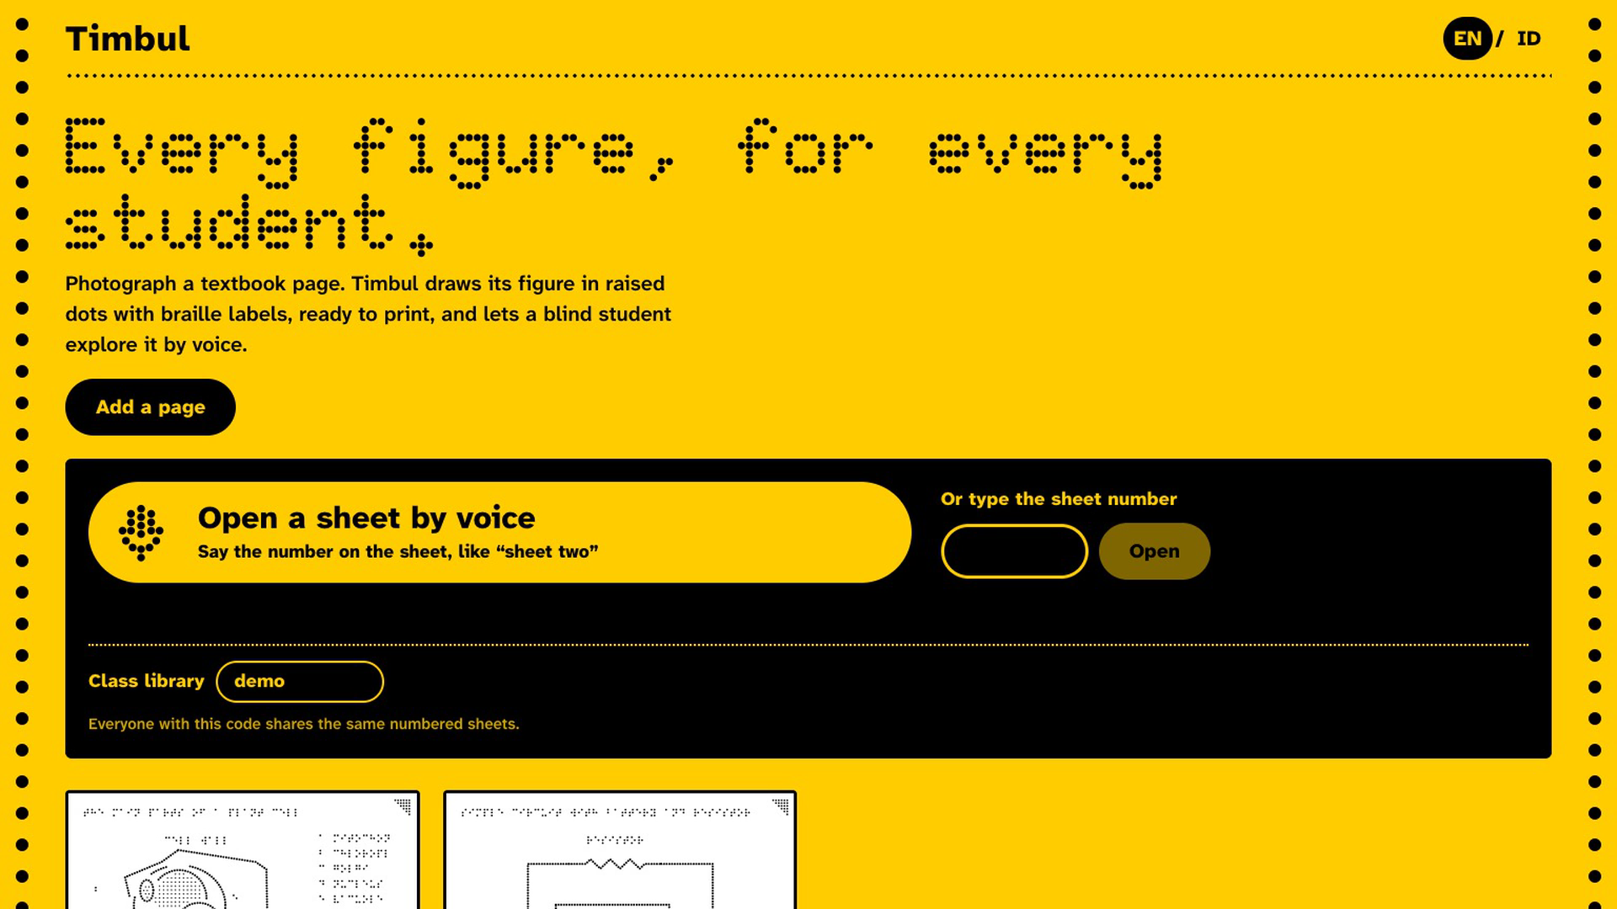
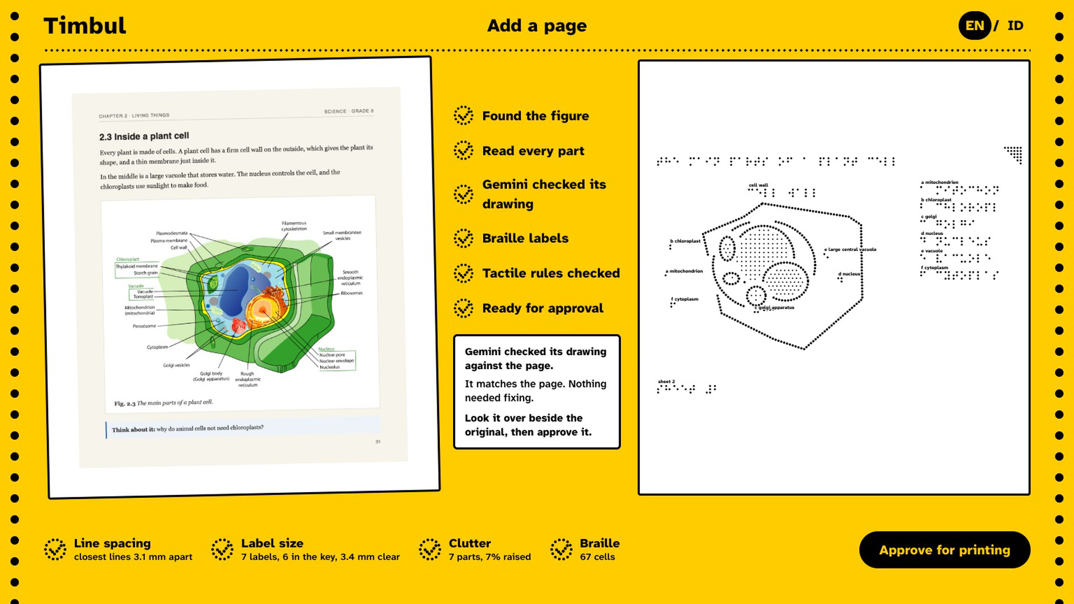
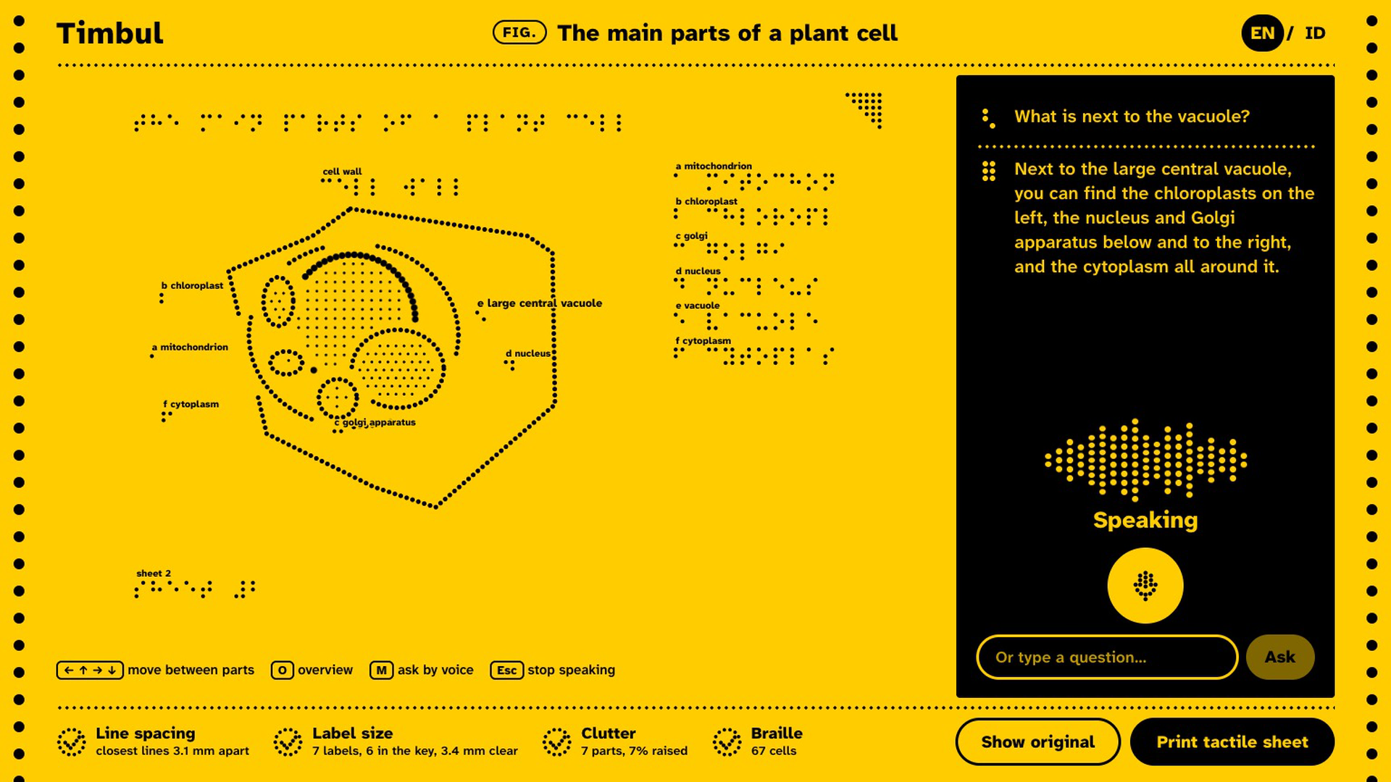
Wireframes/Mock diagrams of the proposed solution (optional): the working screens
Class library: open a sheet by voice, or add a page
Add a page: Gemini's self-check, four checks, approve
Explore: the sheet, part by part, and the voice panel

Slide 7
Architecture diagram of the proposed solution
Gemini 3.8 Flash
Reads the figure, checks its own drawing, finds the fingertip on the sheet.
Browser
Teacher's laptop or phone; student's phone or laptop with a screen reader. React web app.
Firebase Hosting
Serves the web app over HTTPS.
Cloud Run service
One container: the app and the API (/locate, /read, /verify, /ask, /speak, /sheet, /library). Spending guard.
Gemini 3.5 Flash-Lite
Finds the figure; hears questions and sheet numbers; answers.
Timbul's code (in the app)
Dot layout, braille, rule checks, A4 SVG export.
Firestore
The class library: approved sheets, their numbers, shared across devices.
Secret Manager
The Gemini keys, read by Cloud Run; never in code or the browser.
Gemini 3.8 Flash TTS
Speaks every answer and part name.
Gemini is called through Google's Gemini API, trying several Gemini models when one is busy; OpenRouter (the same Gemini models) is the backup. Cloud Run is capped at one instance and the API refuses calls past a daily limit, so the demo stays inside the free tier.

Slide 8
Technologies to be used in the solution
Google AI
Google Cloud
Our own code
App
Gemini 3.8 Flash: reads figures into structured JSON, checks its own drawing, and finds a fingertip on the printed sheet (vision, two images)
Gemini 3.5 Flash-Lite: finds the figure; spoken questions and sheet numbers (audio in)
Gemini 3.8 Flash TTS: Timbul's voice
Fallbacks: Gemini 3.7, 3.6 and 3.5 Flash
Cloud Run: the app and its API
Firestore: the class library
Secret Manager: the keys
Cloud Build and Artifact Registry
Firebase Hosting: the short address
Tactile layout engine: dots, occlusion, label placement
Uncontracted braille in standard 6 mm cells
Four rule checks with automatic fixes
A4 SVG export at real millimetres
React, TypeScript, Vite
Web Audio microphone capture
IndexedDB copy for offline use
Screen-reader labels, keyboard use

Slide 9
Estimated implementation cost (optional)
One figure
Three to five Gemini calls: find the figure, read it, check the drawing (twice at most). Drawing, braille and rule checks run in Timbul's own code.
One question
One small Gemini call, plus one speech call; spoken lines are cached and replayed free.
Hosting
Cloud Run scales to zero and is capped at one instance; Firestore and Firebase Hosting within free allowances.
Printing
Swell paper is about US$1.30 an A4 sheet; fusers cost US$650 to 1,800; embossers from about US$4,700 (HumanWare, RNIB). About 48 Indonesian special schools own the same imported embosser and most no longer work (ITS Sewagati, 2023). So the voice guide works with no printer, and a teacher can build the sheet by hand from Timbul's layout (Perkins collage method).
Who pays
Indonesia's 2,396 special schools (4,229 blind students, Kemendikdasmen 2025), braille production centres such as BLBI Abiyoso, and publishers: PP 13/2020 requires government budgets for students' reasonable accommodation, and Indonesia ratified the Marrakesh Treaty in 2020.

Slide 10
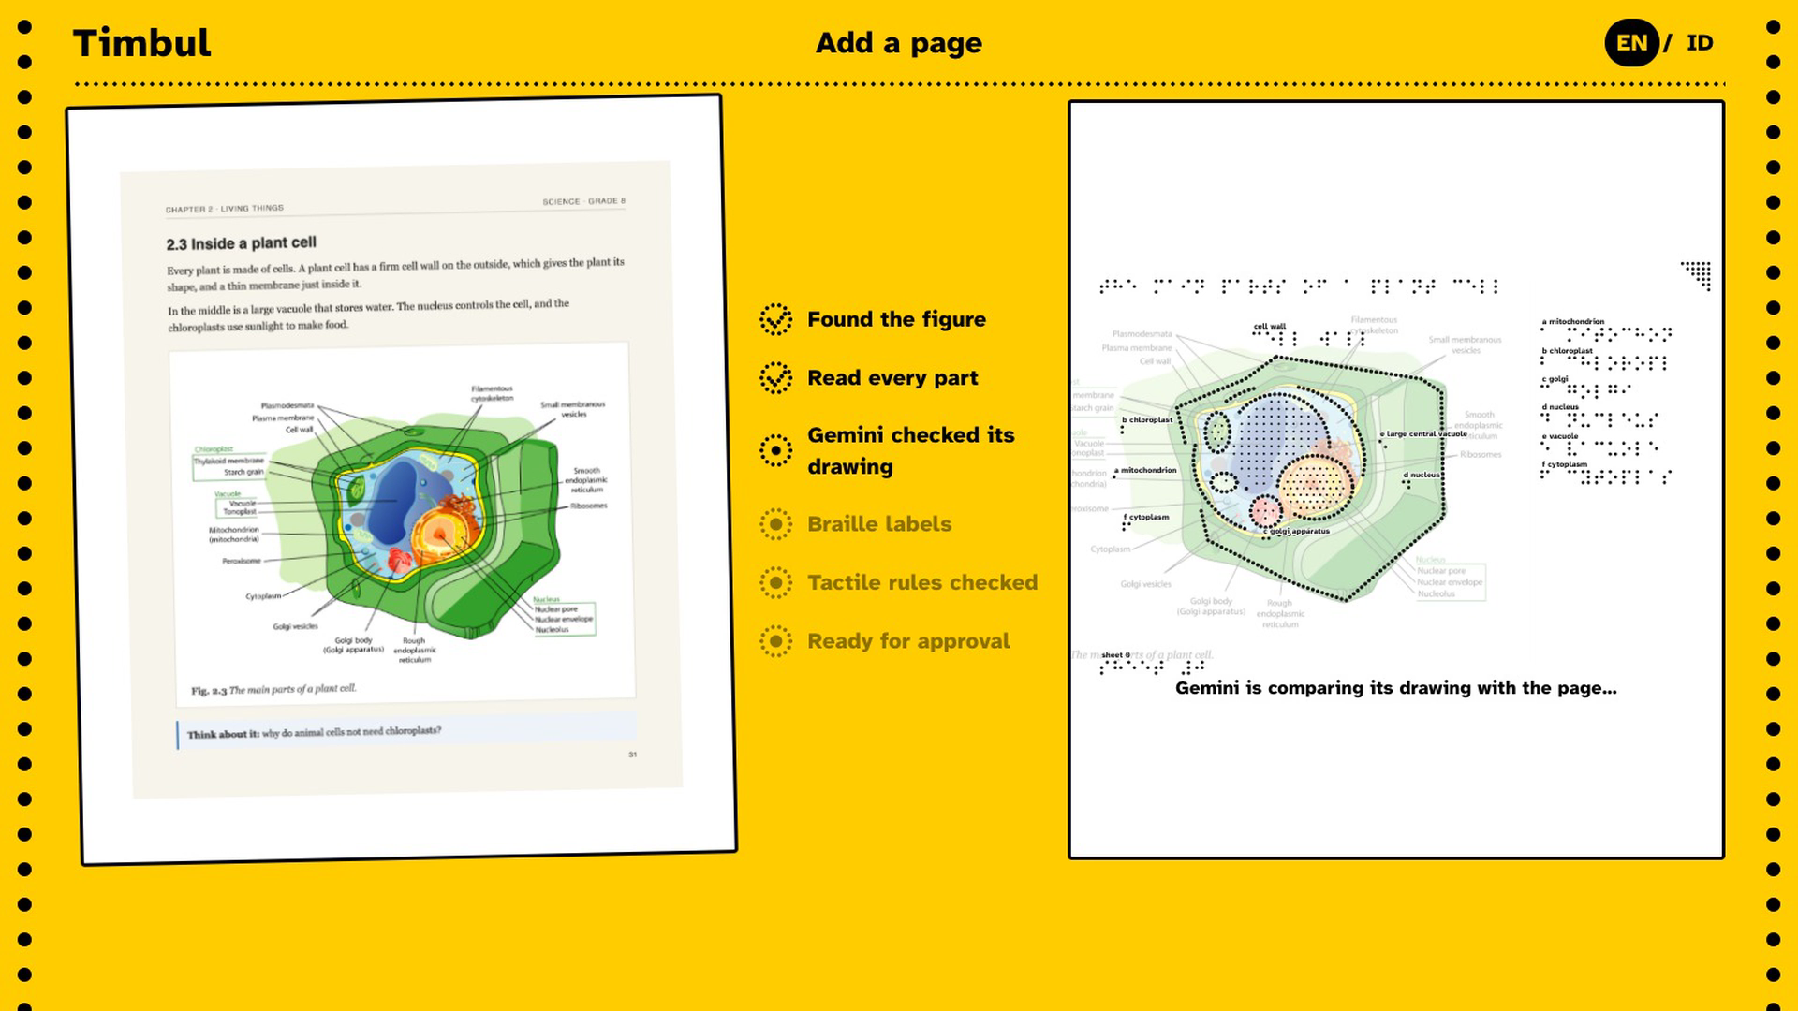
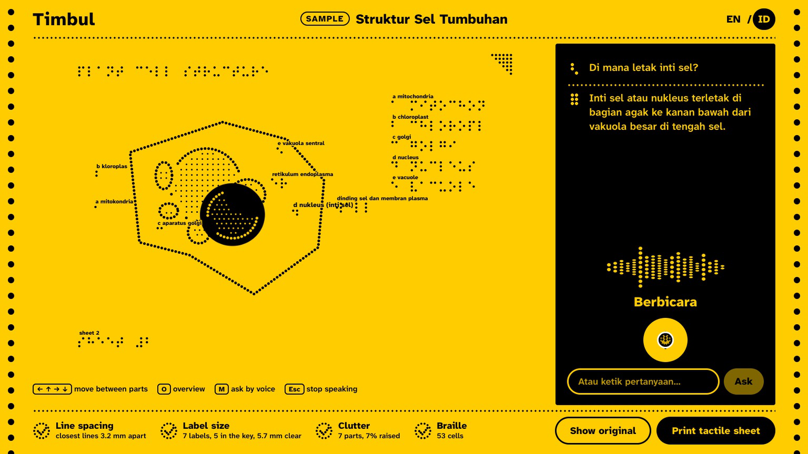
Snapshots of the prototype
Gemini lays its own drawing over the page to check it, before the sheet is drawn and approved.
The same figure in Bahasa Indonesia: a spoken question, a spoken answer.

Slide 11
Prototype Performance report/Benchmarking
4 of 4
about 30 s
Point and ask photos answered correctly: two parts, the same photo upside down, and no finger (7 to 21 s each; test photos were generated, not a real printed sheet)
from a photo of a textbook page to a checked sheet: find the figure 1 to 2 s, read 10 to 26 s, self-check 10 to 35 s (Gemini 3.8 Flash)
1 round
4 of 4
for the self-check to catch a part we moved on purpose (the nucleus) and put it back; the second round confirmed the fix
checks passed by the plant cell page (closest lines 3.1 mm against a 3 mm rule) and by a neural-network diagram after grouping
How we measured: our own runs on 14 and 15 October 2026: a textbook page with an openly licensed plant cell figure, a series circuit, a neural-network diagram and the USGS water cycle, using scripts/check-reading.mjs and scripts/check-point.mjs in the repository.
Honest limits: busy scenes are the weak spot: the water cycle now passes all four checks, but its landscape comes out as large boxy regions. Some key letters sit outside their part when no clear spot is inside. No blind student or teacher has tested Timbul yet, and no sheet has been printed on swell paper yet.

Slide 12
Additional Details/Future Development (if any)
1
Point and ask on real sheets: It works on photos today; next, a phone stand and tests with printed swell-paper sheets and real fingers, then live video instead of a photo.
2
A phone screen built for screen readers: VoiceOver and TalkBack can already swipe through every part; next, a one-button screen for asking and pointing, usable with the screen off.
3
Test with real users: Sessions with blind students and their teachers at special schools in Indonesia and India, then fix what they find.
4
More languages and contracted braille: Tamil, Thai and Vietnamese next; contracted braille through a standard braille library.
5
Shared across schools: Class libraries already share sheets within a class; next, a national library so each textbook figure is made once for every school, with lead lines for labels.

Slide 13
Provide links to your:
GitHub Public Repository: github.com/padmanabhan-r/timbul
Demo Video Link (3 Minutes): youtu.be/vN8Nwi9wOWY
Final Product Link: to be added after deployment

Slide 14


